Slide 1

Bank loan Analysis
GROUP 3

Slide 2




INTRODUCTION
NAVIGATION
INSIGHTS
RECOMMENDATION

Slide 3



NAVIGATION PAGE
KPI 1
KPI 2
KPI 3
KPI 4
KPI 5
KPI 6
KPI 7
DASHBOARD

Slide 4

INTRODUCTION
In today's banking landscape, data holds the key to unlocking operational efficiency, risk mitigation, and customer satisfaction. This project explores the transformative potential of advanced analytics in addressing these core challenges.
Anticipated outcomes include improved decision-making, enhanced risk management, increased efficiency, greater customer satisfaction, and a competitive advantage.
In summary, this project showcases how advanced analytics can revolutionize banking operations, driving growth and resilience in an ever-evolving industry.
The Dataset included 2 files namely 'Finance1' and 'Finance2' which we merged on common column 'id' in Power Query Editor and created one Merged Dataset.

Slide 5
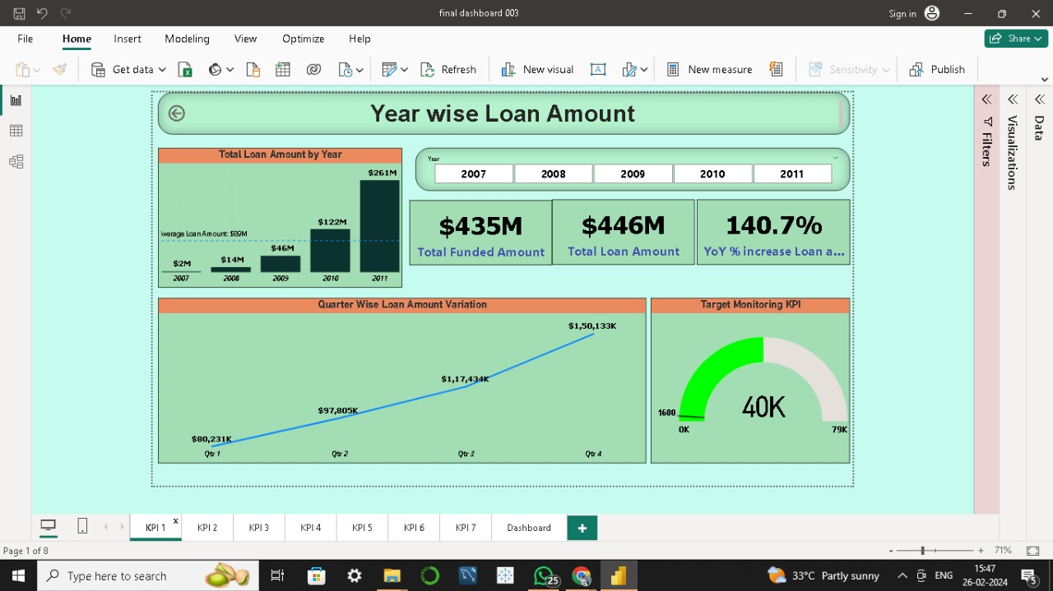

SUMMARY

Slide 6
KPI NO 1:- YEAR WISE LOAN AMOUNT
This KPI helps us to understand the variation in Total Loan Amount given by the bank for the Years 2007,2008,2009,2010,2011 in the form of Bar chart.
With the help of Year Slicer and Drill feature we can also dive deeper into every Year, Quarter, Month of that year to see the variation in loan amount in the form of Line chart.
With the addition of KPI cards we can get the exact Loan Amount, Funded Amount, Year over Year percentage increase in Loan Amount of any particular year.
With the help of Gauge chart we can monitor Customer Acquisition Target status of every Year.

Slide 7
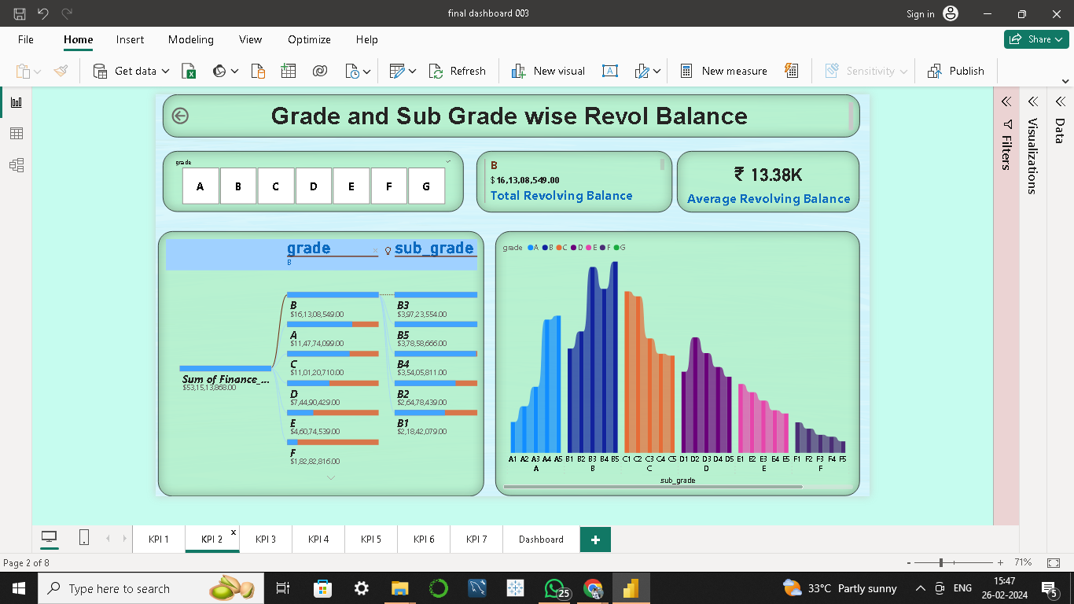
SUMMARY

Slide 8
KPI NO 2:- GRADE AND SUB-GRADE WISE REVOLVING BALANCE
Revealed higher average revolving balances in higher grades (B, A), indicating potentially more affluent borrowers.
Identified certain sub-grades (e.g., F4 ,F5) with unexpectedly lower balances, warranting further investigation into borrower characteristics.
Emphasized the need to consider both grade and sub-grade levels for comprehensive borrower behaviour analysis and risk assessment.

Slide 9
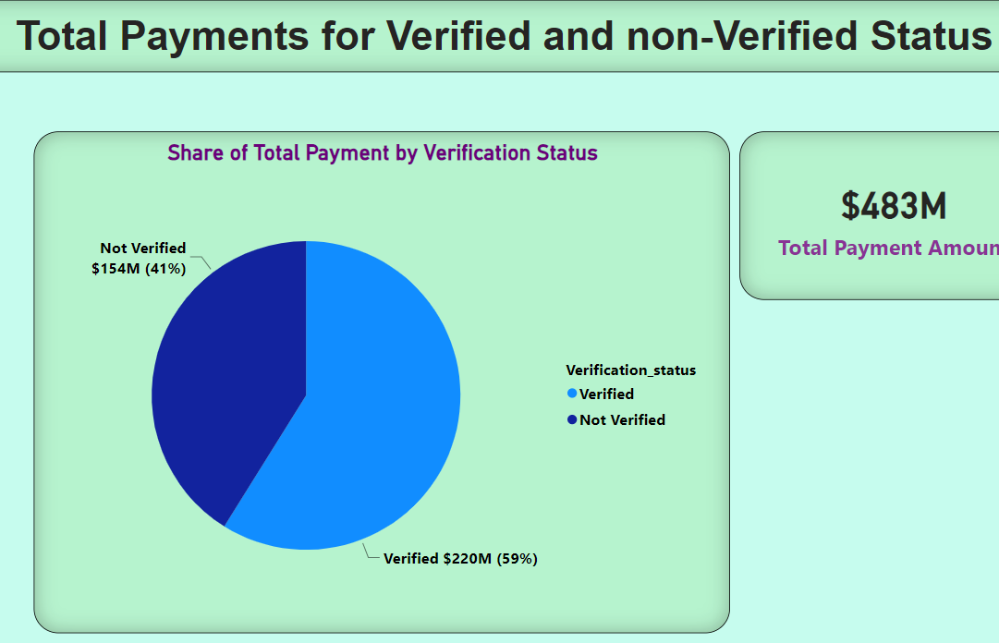
SUMMARY

Slide 10
KPI NO 3:- TOTAL PAYMENT FOR VERIFIED AND NON-VERIFIED STATUS
Each segment in the pie chart represents a different verification status.
Payments are categorized based on their verification status for easier analysis.
Values and percentages within the pie chart segments represent total Visualization and navigation features aim to provide a clear understanding of payment verification status.

Slide 11
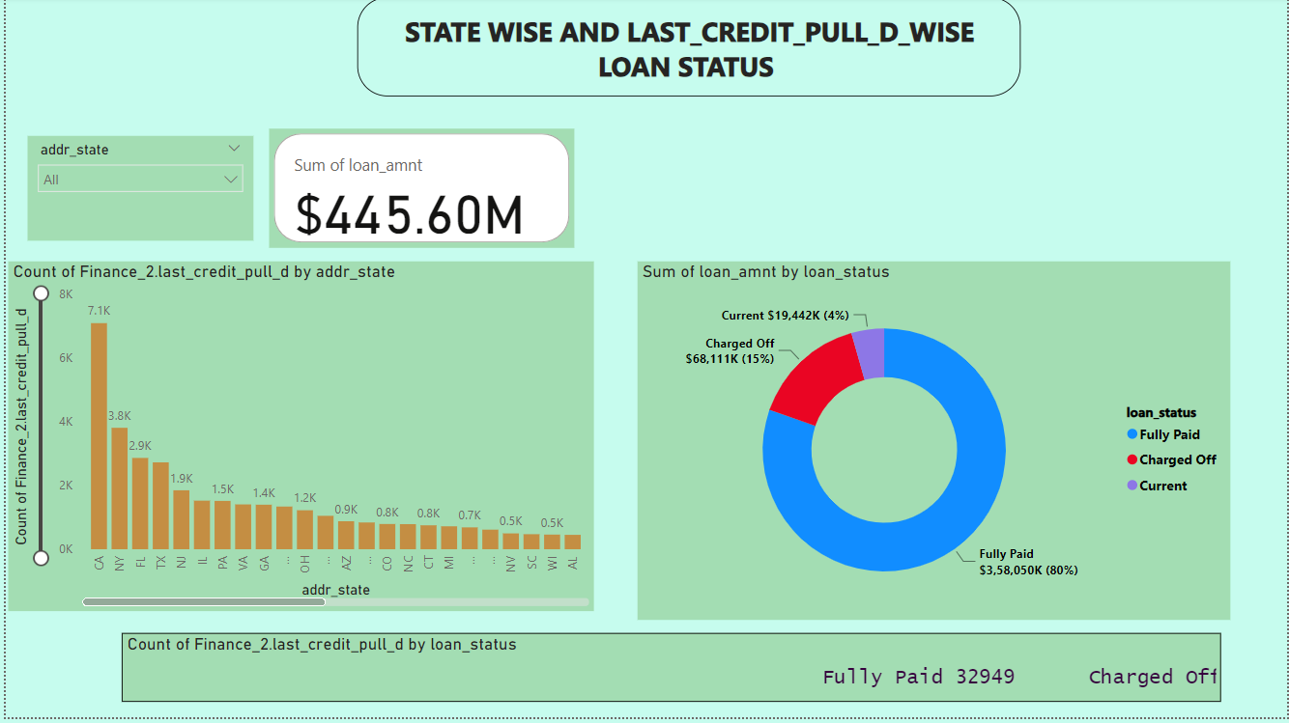
SUMMARY

Slide 12
KPI NO 4:- STATE WISE AND LAST CREDIT PULL DATE WISE LOAN STATUS
It involves categorizing and analysing loans based on the geographical location or state in which they were originated or currently held. This analysis provides insights into regional trends, market condition, and regulatory impacts on loans. It shows current state condition of loans within given dataset.
In Dashboard we can see California is the highest city in all 3 types of loan status charged off, fully paid and current as compare to that Lowest record city is Maine where only fully paid loan status is there.
Combining state wise and last credit pull date wise analyses offers a comprehensive understanding of loan performance and borrower dynamics.
Continuous monitoring and evaluation of loan portfolios based on both geographical factors are essential for maintaining a healthy credit ecosystems and achieving sustainable growth.

Slide 13
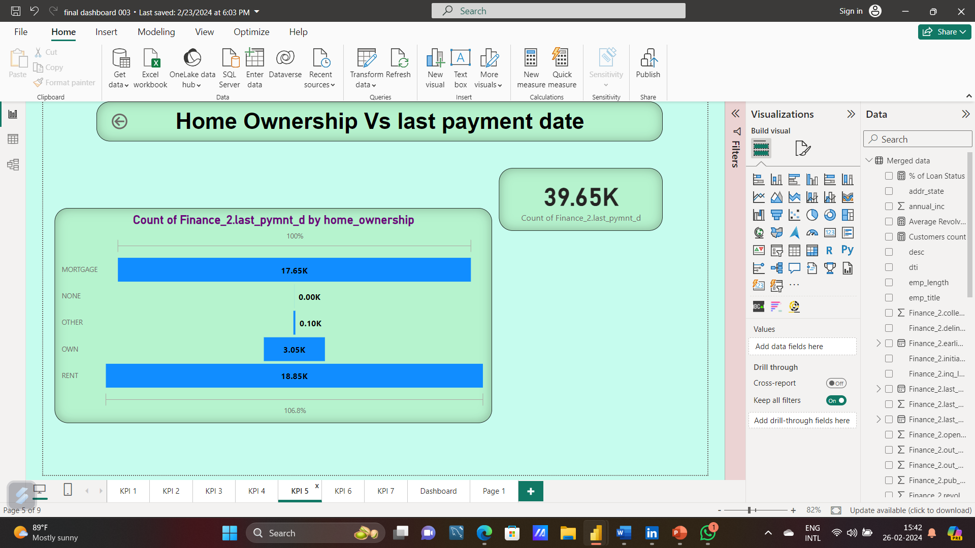
SUMMARY

Slide 14
KPI NO 5:- HOME OWNERSHIP AND PAYMENTS ANALYSIS
Reveals about home ownership and last payment dates of home.
Shows that people prefer to live for rent or mortgage.
Through drill down this funnel chat says that 2013, placed a highest payments in rent, mortgage, own which is 9456(count).
Highest payments are effected by annual income and loan amount
Rent and Mortgage payments may indicate financial strain of individuals.
Even Though loan amount increased gradually very few people live in own homes.

Slide 15
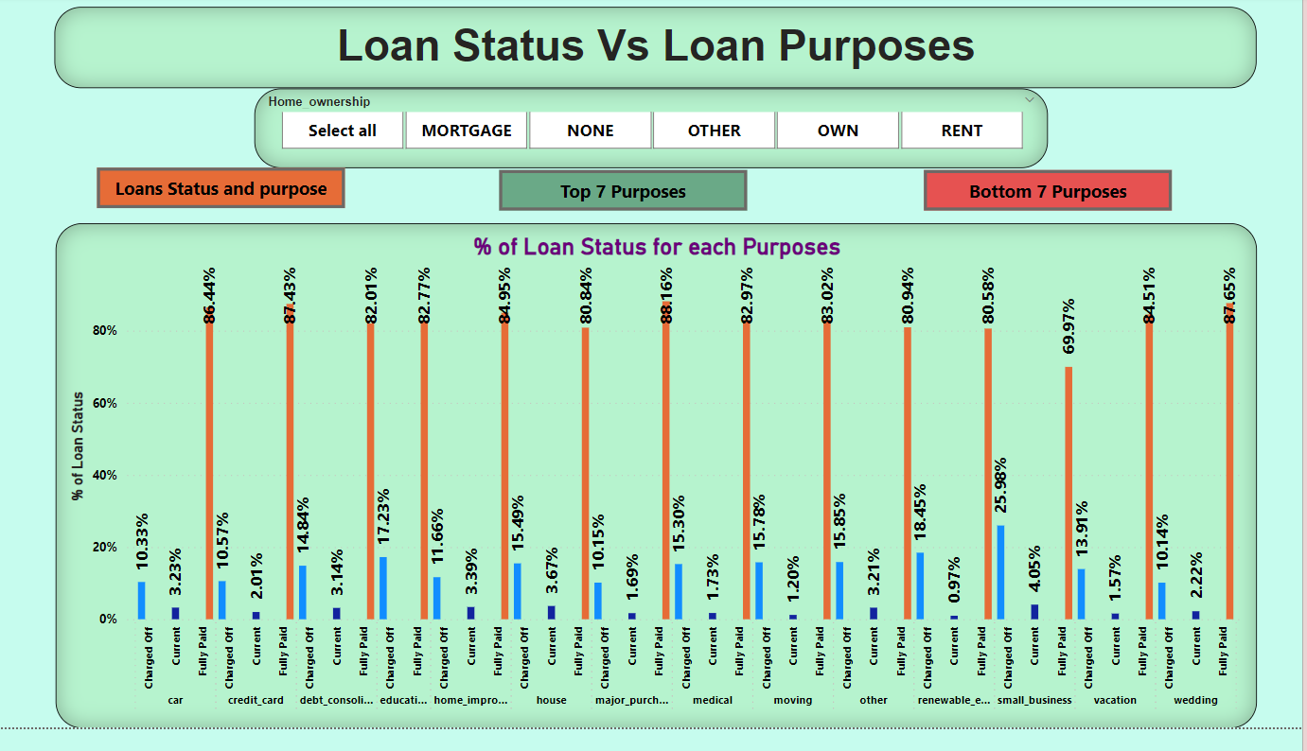
SUMMARY

Slide 16
KPI NO 6:- % LOAN STATUS V.S LOAN PURPOSES
Helps to understand the distribution of Loan Status in different loan purposes for a particular ownership.
Which helps the bank to understand which purpose of loan is doing good in terms of loan status and how much loan amount is assigned to that purpose based on that bank can increase the loan amount.
And also bank can try to understand what all the factors effecting the loan status of particular purposes which is not doing good.

Slide 17
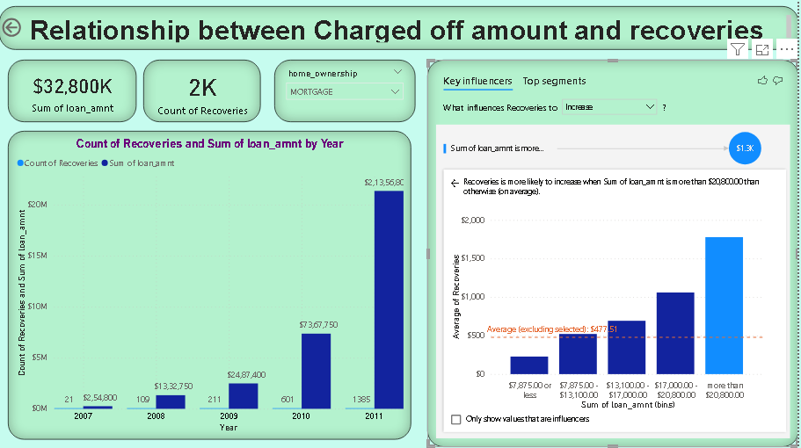
SUMMARY

Slide 18
KPI NO 7:- CHARGED OFF AND RECOVERIES
This can help us check yearly recovery efficiency, recovery strategy, risk assessment etc.
Outcome : threshold effect which suggests that loan amount more than $ 20,800 will increase the recoveries.
Assumed reason : larger loan amount is associated with more table borrowers and higher collateral.

Slide 19
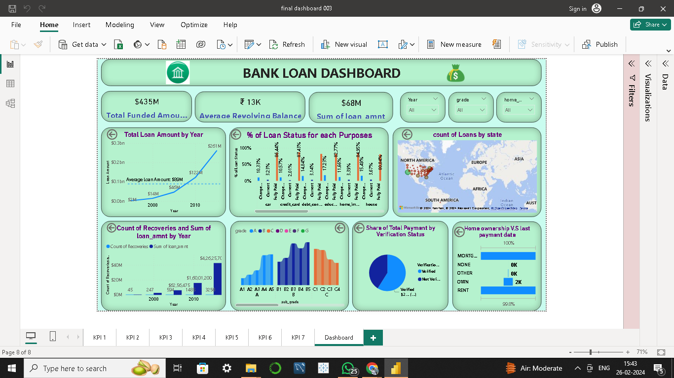

Slide 20
INSIGHTS
KPI 1: There is an Exponential increase in Total Loan Amount over a Period of 5 Years from 2007 to 2011.
KPI 2: Higher grades tend to have higher revolving balances.
KPI 3: Verified status borrowers exhibit higher total payments.
KPI 4: Loan status varies across states and is influenced by recent credit pulls.
KPI 5: Renters show more stable payment behaviour compared to others.
KPI 6: Certain loan purposes may have higher default rates.
KPI 7: Fully paid loans have the highest approval rate.

Slide 21
Recommendations:-
Use a more detailed sub-grade system for better risk analysis.
Include more borrower information for deeper insights.
Explore real-time data integration for more up-to-date analysis.
Limitations of the Datasets:-
Include additional borrower information beyond grade and sub-grade levels for deeper analysis.

Slide 22
THANK YOU!!

Slide 23
GROUP MEMBERS:-
Abhinav R Kumbalwar
Tripati Sahu
Yashashree D Gadre
Himanshu K Deoghare
Swathika Jangiti
Megha Rangaswamy
Kangam Gamlin

